Slide 1
Working Healthy/WORK Training

Slide 2

Working Healthy/WORK Training
WELCOME
WORKING HEALTHY/WORK: PRESENTATION
Target Audience: Working Healthy Professionals, MCO, Assessors, ILC, Other Agency Providers, etc.
Revised: 10/1/2024

Slide 3
Working Healthy/WORK Training
MODULE 14
WORK Assessment 102
Presenter: Sherri Marney, BSHS/M, WORK Program Manager
Length of presentation: 1 hour 42 minutes

Slide 4
Working Healthy/WORK Training
Goals and Objectives
Learn about collecting information | Learn about the WORK MFEI Information
Learn the meaning of performance and capacity | Learn about completing the information sheet
Learn about residency form | Learn about health-related information
Learn about diagnosis information

Slide 5
Working Healthy/WORK Training
Acronyms To Know:
ADLs = Activities of Daily Living | BI = Brain Injury
CDDO = Community Developmental Disability Organization | IADLs = Instrumental Activates of Daily Living
I/DD = Intellectual / Developmental Disability | ISP = Informal Support Policy
PAS = Personal Assistance Services | PERS = Personal Emergency Response System
POA = Power of Attorney | PD = Physical Disability
ROM = Range of Motion | WHBS – Working Healthy Benefit Specialist
WORK = Work Opportunities Rewards Kansans | ADA = Americans with Disabilities Act
MCO = Managed Care Organization | NEMT = Non-Emergency Medical Transportation

Slide 6
Working Healthy/WORK Training
Getting Started
Complete all sections of the assessment through dialogue with the member.
1. Look at previous assessments.
All existing members will have a previous assessment. It is helpful to look at the previous assessment so you can ensure discussion of previous limitations and any changes to those conditions. Then you should ask about any new limitations.
2. Assessed need based on current function.
Sometimes a member may say, “…the same as last year.” However, conditions change.
3. ILCs encouraged to attend assessments. ILCs should attend assessments. The ILC is tasked with assisting members in the development of the budget. Therefore, it can be helpful for the ILC to be present to hear the member and Assessor discuss limitations and abilities.
4. Members are assessed not guardians. Members are expected to actively participant in their assessment. No one other than a legal guardian can answer for a member. However, the member needs to voice their opinion about their limitations and abilities if a guardian answers. At no point should a provider participate in the assessment.

Slide 7
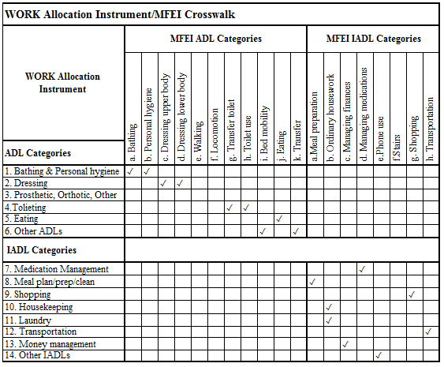
Working Healthy/WORK Training
WORK MFEI Information
HCBS is set to use the Kansas Medicaid Functional Eligibility Instrument (MFEI).
WORK uses the WORK Needs Assessment and Allocation tool.
Both tools use ADL and IADL support categories. The categories and coding contained within the MFEI are referenced throughout the WORK Needs Assessment and Allocation tool both to improve the instrument now and to create consistency across these instruments in the future.

Slide 8
Working Healthy/WORK Training
Level of Care and Level of Need
What is the level of care needed to support the member’s level of identified needs?
Level of Care (LOC)
The LOC helps determines the member’s program eligibility for WORK services.
Can the member demonstrate a need for ADLs, IADLs, Supported Employment, etc.?
Is there supporting documentation that reflects the justification for this care?
  Social Security Administration determined disability
  Medical diagnosis
    Level of Need (LON)
A member’s LON is used to determine the amount of time the member needs for specific tasks.
At the top of each “Supports for PAS Needs” page is a “Time per Task” guide. Use this to help identify tasks in each category that the member needs assistant with.
  The LON is obtained by identifying the need and assigning an amount of time.

Slide 9
Working Healthy/WORK Training
MFEI Numeric Coding Guidance
When considering the level of need, refer to the below table and the “Time per Task” guide at the top of each support page.
Numeric Code | Guidance Description
0 = Independent | No physical assistance, setup, or supervision.
1 = Set-up help only | Article or devise provided or placed within reach, but not physical assistance or supervision.
2 = Supervision | Oversight, cueing or prompting is provided.
3 = Limited assistance | Guided maneuvering of limbs, physical guidance without taking weight, or help on some occasions.
4 = Extensive assistance | Weight-bearing support (including lifting limbs) and help throughout task(s) but person still performs 50% or more of the task on his/her own.
5 = Max assistance | Weight-bearing support (including lifting limbs) and person performs less than 50% of the task on his/her own.
6 = Total dependence | Full performance by another person(s) throughout entire task.

Slide 10
Working Healthy/WORK Training
Performance
Capacity
Capability
Click for info
Click for info
Click for info
Capacity refers to a person’s aptitude and skill to perform an activity in a standardized, controlled daily environment.
Performance refers to a person’s ability to perform an activity in hers/his daily environment. If you have an ability, you know how to do something.
Capability refers to what a person can do in hers/his daily environment. If you have a capability, you have the power to do something.

Slide 11
Working Healthy/WORK Training
Performance
Guidance for Performance (b, "How did you get this done in the last 3 days?"):
Consider all tasks within each category and how each task is performed.
  Is the member completing the task independently?
  Is someone assisting the member to complete the task?
  Is the member using technology or assistive aids to complete the task?

Slide 12
Working Healthy/WORK Training
Capacity
Guidance for Capacity (c, "How much/what aspects of these tasks can you do safely on your own?"):
Capacity should be based on presumed aptitude and skill to carry out activity safely. Capacity should be considered in determining time allocations - not just performance. In a majority of instances performance and capacity will be similar.
However, capacity and performance may differ some situations:
Capacity to complete task but not doing.
Click to Advance
Task not getting completed.
Click to Advance
Task is being completed but not safely.
Click to Advance

Slide 13
Working Healthy/WORK Training
SCENARIO
  The member has the capacity to complete meal preparation. This is demonstrated in the member’s employment at a restaurant. The member’s PAS provider is a family member that does not live with the member. The member is tired at the end of the day and wants the PAS provider to prepare evening meal.
Is there a policy relative to this request?
  Yes.
What is the policy?
  EMPLOYMENT TASKS VS ASSESSED TASKS
  Assistance with ADLs and IADLs is not provided for members who are performing similar tasks at their place of employment.
Is it appropriate to add time?
Click for answer.
Employ due diligence
Click for answer.
No

Slide 14

Working Healthy/WORK Training
SCENARIO
  The member has the capacity to complete meal preparation. This is demonstrated in the member’s employment at a restaurant. The member’s PAS provider is a family member that does not live with the member. The member is tired at the end of the day and wants the PAS provider to prepare evening meal.
No
Is there a policy relative to this request?
  Yes.
What is the policy?
  EMPLOYMENT TASKS VS ASSESSED TASKS
  Assistance with ADLs and IADLs is not provided for members who are performing similar tasks at their place of employment.
Back to Previous

Slide 15
Working Healthy/WORK Training
SCENARIO
  The member does not have the capacity to complete housekeeping tasks due to limited mobility and vision impairment. Time is assessed for total support (getting the maximum amount of time) which is 2 hours per week. However, the member does not have a provider willing to go into the home. The dirty / cluttered condition of home is putting the member endanger of eviction. The member does have a history of hoarding and refusing assistance.
How is the need being met?
Click for answer.
The need is not being met.
Is there a policy relative to this request?
  Yes.
What is the policy?
  CLEANING
  WORK doesn’t provide extra oversight/assistance related to:
    Extra time for cleaning.
    Cleaning related to hoarding or infestations.
    Organizing, packing, and/or putting things into/out of storage.
Employ due diligence
Click for answer.
Click for More Info

Slide 16
Working Healthy/WORK Training
SCENARIO
  The member does not have the capacity to complete housekeeping tasks. Time is assessed but the member does not have a provider available to compete the tasks. The condition of the home is putting the member endanger of eviction. The member is requesting to hire an agency that charges $50 per hour, minimum of two hours per visit. The member does have a history of hoarding and refusing assistance.
Is there a policy relative to this request?
  Yes.
What is the policy?
  CLEANING
  WORK doesn’t provide extra oversight/assistance related to:
    Extra time for cleaning.
    Cleaning related to hoarding or infestations.
    Organizing, packing, and/or putting things into/out of storage.
The need is not being met.
Click for More Info
Back to Previous

Slide 17
Working Healthy/WORK Training
Consider this…
A member has the right to chose how they live.
  If the member refuses assistance, this is a choice.
  If the member doesn’t like to clean, so doesn’t, this is a choice.
When you have the right to make decisions, you have the responsibility of owning the consequences.
  Is there a chance that providers will refuse to work in an environment they find too unclean? Yes, this is a consequence.
  Is there a chance the member could be evicted? Yes, this is a consequence.
If there are no serious concerns with member health and safety, it is best practice to honor the member’s choice.
If there are concerns with the environment and the impact on the health and safety of the member, then an APS report may be needed.

Slide 18
Working Healthy/WORK Training
SCENARIO
  The member does need assistance transferring in/out of shower/tub. The member purchased grab bars but hasn’t found anyone to install them. Arthritis seriously limits the ability to bend knees in order to step over the edge of the tub. Stepping out of the shower/tub has resulted in several falls over the past year. The member works third shift and has not been able to find a provider that can assist either before or after the member’s work schedule.
Is there documented evidence of injury/harm?
  Yes. Medical documentation.
Identify the reason the task is being preformed unsafely.
  Lack of provider.
Is there something that can be done to reduce the risk of harm?
  Yes. Find a provider to install the grab bars. Would a shower chair help increase safety? Look into a bath modification.
Yes
Employ due diligence
Click for answer.
Is there risk of injury?
Click for answer.

Slide 19
Working Healthy/WORK Training
SCENARIO
  The member does need assistance transferring in/out of shower/tub. The member purchased grab bars but hasn’t found anyone to install them. Arthritis seriously limits the ability to bend knees in order to step over the edge of the tub. Stepping out of the shower/tub has resulted in several falls over the past year. The member works third shift and has not been able to find a provider that can assist either before or after work.
Is there documented evidence of injury/harm?
  Yes. Medical documentation.
Identify the reason the task is being preformed unsafely.
  Lack of provider.
Is there something that can be done to reduce the risk of harm?
  Yes. Find a provider to install the grab bars. Would a shower chair help increase safety? Look into a bath modification.
Yes
Back to Previous

Slide 20
Working Healthy / WORK Training
Tips Page
    This is a tab (page) that contains tips related to different functions of the instrument and directions.
    For example: Not all cells need to expand. However, cells that require you to type in a narrative need to expand so the information can be seen. Due to the way this instrument was originally developed and due to various merged cells, the only way to accomplish getting a cell to expand is to force the expansion. Therefore, you need to know the trick to make this work.
    When you type in cells that require a narrative, the cell now has the ability to expand.
    You will need to double click in the cell after you have typed what you want and hit enter to force the cell to resize.
    If you are removing something from an expanded cell you may need to double-click in the cell, delete what you want deleted, then hit enter to force it to collapse.

Slide 21
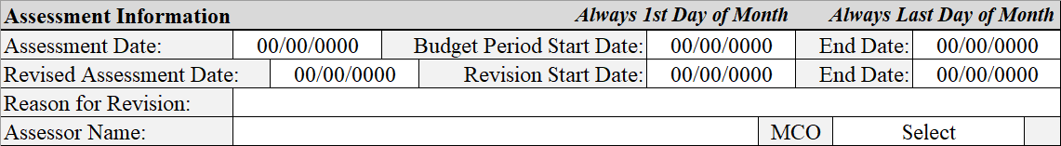
Working Healthy/WORK Training
Assessment Information
Assessment Type and Dates
Budget Dates
Assessor Information

Slide 22
Working Healthy/WORK Training
Assessment Types
Initial: This is the very first assessment.
Annual: This is the yearly assessment.
Revised: This is when an initial or annual assessment needs revised and must include reason for revision.

Slide 23
Working Healthy/WORK Training
Assessment Dates
Assessment Date:
Date the initial or annual assessment was completed. This goes on the first row.
Revised Assessment Date:
Indicate when the revised assessment was completed.
Reason for Revision:
Indicate the reason for this revision.

Slide 24
Working Healthy/WORK Training
Assessment Information
Budget Dates

Slide 25
Working Healthy/WORK Training
Budget Dates
All budgets have an assessment it corresponds to.
Budget Period Start Date: When the corresponding budget will begin.
  If the assessment is the initial or very first assessment, the budget period start date may not be known or may change depending on when WORK opens. Therefore, you can leave this blank until the start date is known, then update your assessment.
  If this is an annual assessment the budget period start date is not known.
  This start date will always be the first day of the month.

Slide 26

Working Healthy/WORK Training
Budget Dates
Revision Start Date: This is when the revised assessment will go into effect.
If there is a decline in health, we don’t want to make a member wait until the first of the following month to start the budget.
These assessments can be started at the first of the month, in the month revised assessment was completed.
End Date: This is when the corresponding budget expires.
  This will always be the last day of the month.

Slide 27
Working Healthy/WORK Training
Assessment Information
Assessor Information

Slide 28
Working Healthy/WORK Training
Assessor’s Name:
The name of the MCO Assessor completing the assessment.
ASSESSOR INFORMATION
Assessments are completed by the MCO
MCO:
The name of the member’s MCO.

Slide 29
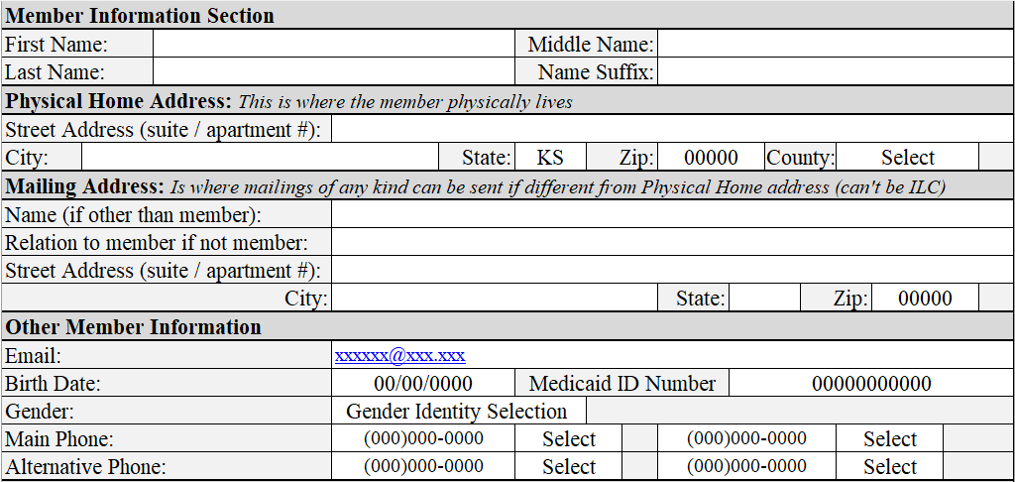
Working Healthy/WORK Training
Member Information
Complete: Name
Street Address, City, State, and Zip: Member’s physical address. Add any alternative mailing address
County: County where the member resides
Email: Complete if the member has an email address; otherwise leave blank
ACCURACY OF INFORMATION IS VITAL
Complete: Birth Date, Gender, Social Security Number, Medicaid ID Number, Home Phone, and Other Phone.

Slide 30
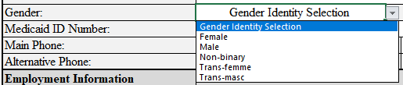
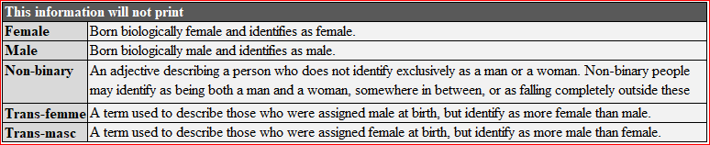
Working Healthy/WORK Training
  New “Gender Identity Selection.” This is to allow more inclusive options for individuals other than just female and male.
  To the righthand side of the Member Information page you will find some additional information to help you decide what is the most appropriate option to select. This information will not print when you print this page.

Slide 31
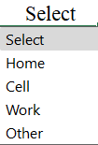
Working Healthy/WORK Training
  More options and places for phone numbers. You now have up to 4 places for phone numbers listed for the member. There are other places you can included contact phone number of guardians, reps, etc.
  Being able to contact a member is very important. The more numbers we have, the easier it will be to connect with the member.

Slide 32
Working Healthy/WORK Training
WORK is part of Working Healthy, which is an Employment program. Employment is part of eligible for WORK services. If someone is not currently employed, they need to be on a Temporary Unemployment Plan (TUP).
Employment impacts WORK supports. If someone’s employment is janitorial in nature, the member is demonstrating the ability to complete related tasks. Therefore, WORK would not provide similar supports.
Employment
Program Employment Criteria Defined
Click for Info

Slide 33
Working Healthy/WORK Training
Program Employment Criteria Defined:
Employment that is integrated and competitive.
Employment must compensate the member at or above minimum wage.
Wages must be subject to FICA or SECA payroll taxes.
The following do not meet Working Healthy employment criteria and WORK provides no support related to the following:
  Sheltered workshops.
  Unpaid internships.
  Volunteer jobs.
  Temporary lay off regardless of reason, even if medical leave.

Slide 34
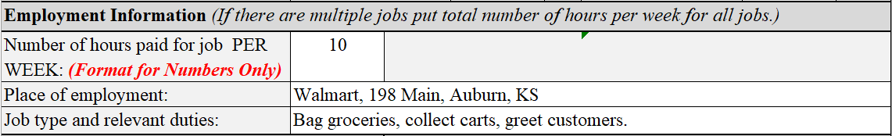
Working Healthy/WORK Training
Hours per Week of Employment
Place of Employment
Type of Employment
Employment Information
Click for Info
Click for Info
Click for Info
Click to Reveal
Click to Reveal
Click to Reveal

Slide 35
Working Healthy/WORK Training
Continue to Next
Hours per Week of Employment
Place of Employment
Type of Employment
Employment Information
Click for Info
Click for Info
Click for Info

Slide 36

Working Healthy/WORK Training
Number of Employed Hours Each Week:
This can be an estimate. If someone works 10 – 15 hours a week
  If someone works 10 to 15 hours per week, input the average of 12.5.
  The tool will automatically round to the nearest whole number.
    12.5 = 13
    12.25 = 12
  Only put numbers in this section. Do not put the following into this section.
    12 hours or 12hrs
    10 - 15
    three hours

Slide 37

Working Healthy/WORK Training
Averaging Employment Hours
Employed work hours per week directly impact the number of hours a member can have for Supported Employment.
If a member needs supported employment but only provides a range of hours, example, 10 -15, time will be calculated based on the info the member provides. 10h + 15h = 25h $÷$ 2 = 12.5h = 13h (rounded)
The more information about work hours the closer to a good average you can get. Example: Wk 1 = 10h, Wk 2 = 15h, Wk 3 = 12.5h, Wk 4 = 15h, Wk 5 = 14h, Wk 6 = 15h. Calculate average: 10h + 15h + 12.5h + 15h + 14h + 15h = 81.5h $÷$ 6 = 13.58h = 14h (rounded)
We can’t change time from 1 week to another. The Assessment tool is based on 1 month. Even though weekly time is calculated, the monthly allocation (money to pay for supports) is calculation based on 1 month not 1 week.

Slide 38
Working Healthy/WORK Training
Place of Employment:
Indicate where the member is employed.
If transportation to and from employment needed, include the work address.
Lack of employment means the member is not eligible unless there is an approved temporary unemployment plan (TUP). This can only be approved by the Working Healthy Benefit Specialist (WHBS).
If no employment and no TUP, collect the following information:
When did the member lose employment?
Reason for loss of employment?

Slide 39
Working Healthy/WORK Training
Type of Employment and List of Relevant Job Tasks:
Indicate what kind of tasks the member performs on the job.
Example 1: Wal-Mart stocker – stocking shelves with merchandise.
Example 2: Receptionist – answer phones and general office work.
Example 3: Personal Assistance Service (PAS) provider – supervision, cueing or prompting, transportation, and activity accompaniment.

Slide 40
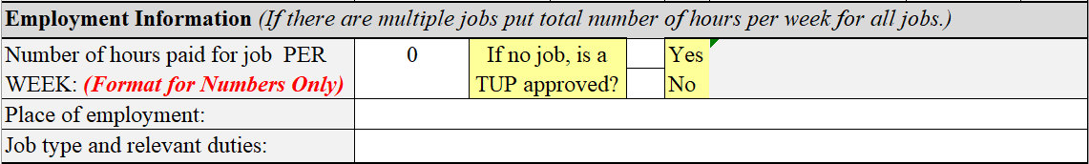
Working Healthy/WORK Training
WORK Eligibility is Contingent on Employment:
Employment information is collected during the assessment. The Assessment tool will automatically provide a variety of messages to guide the Assessor.

Slide 41







Working Healthy/WORK Training
WORK Eligibility Includes Employment:
If the member is not employed, a zero will be needed in the below.
Auto messages click here
3 times
You then need to answer the question about a TUP.
Click the Xs
Yes
No
Oops
X
X
X

Slide 42
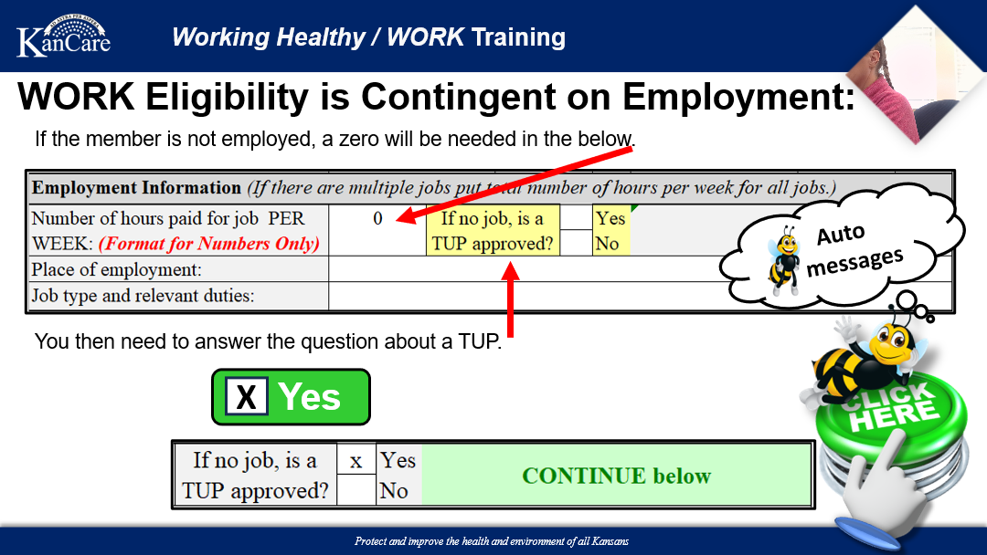
Working Healthy / WORK Training

Slide 43
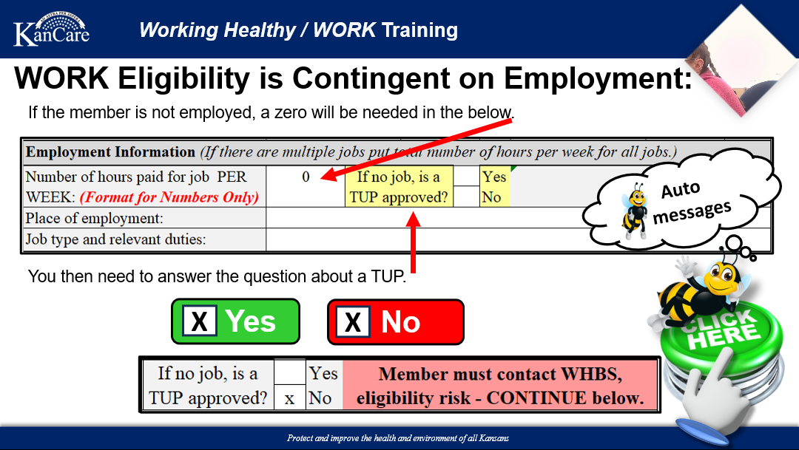
Working Healthy / WORK Training

Slide 44
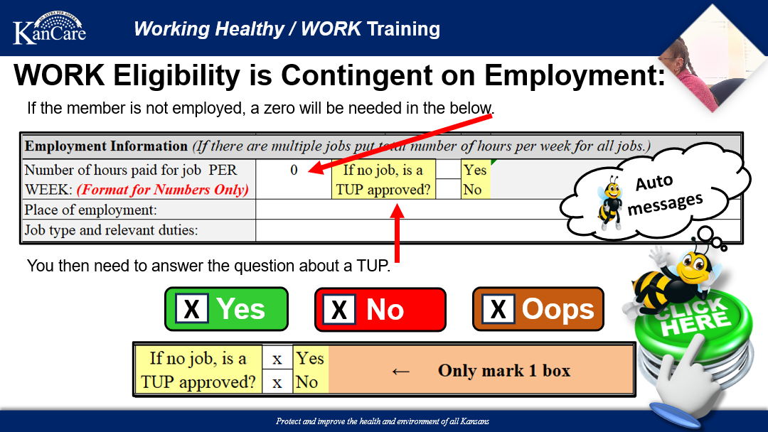

Slide 45
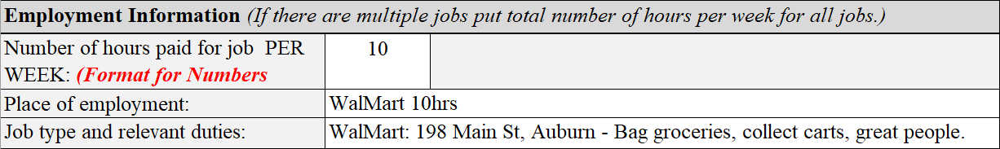

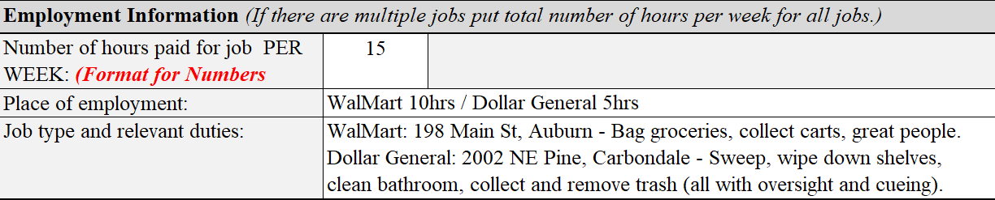
Working Healthy/WORK Training
All Paid Employment Must Be Identified:
Example for 1 Employer:
No auto message due to employment hours.
Example for 2 Employers:
(If there are multiple jobs put total number of hours per week for all jobs.)
WalMart 10hrs
Dollar General 5hrs
WalMart: 198 Main St, Auburn - Bag groceries, collect carts, great people.
Dollar General: 2002 NE Pine, Carbondale - Sweep, wipe down shelves, clean bathroom, collect and remove trash (all with oversight and cueing).

Slide 46
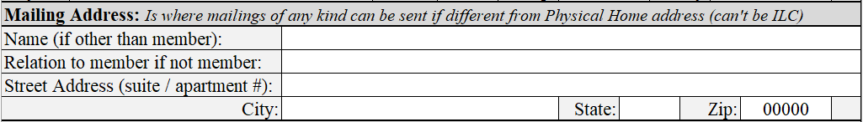
Working Healthy/WORK Training
Alternative Mailing Address
This section provides an opportunity to list an alternative mailing address, such as a PO Box, or the address of the member’s parent if not listed under Guardian/Representative. Do not put the ILCs address, ILC info is listed at the end of the assessment tool.

Slide 47
Working Healthy/WORK Training
Guardian vs. Representative
The Guardian is the person who helps participants with discussions about needed supports, can make decisions on behalf of the member, and may assist to self-direct services.
A Guardian is formally appointed and has legal authority.
The Guardian is not permitted to be paid providers of services.
The Representative is the person who helps participants with discussions about needed supports, can help the person with decisions, and may assist to self-direct services.
A Representative does not have to have legal authority; this may just be a Representative for the WORK program and can be informal.
Representatives are not permitted to be paid providers of services.

Slide 48
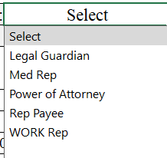
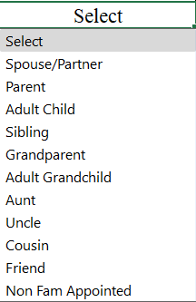
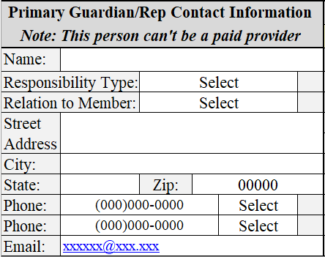
Working Healthy/WORK Training
Responsibility Type
Relation to Member
Note: This person cannot be a paid provider
Note: This is not the place to list the ILC. ILC’s cannot act as representatives of behalf of members. A representative may be a legal guardian, DPOA, etc.

Slide 49
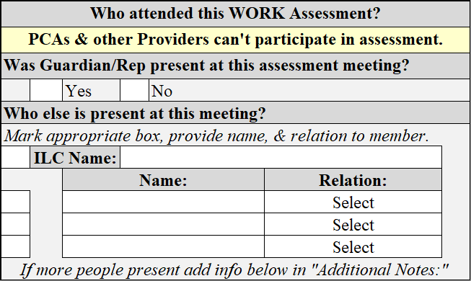
Working Healthy/WORK Training
Assessment Attendance Information
Who else is present at this meeting? Make sure to list everyone who was at the assessment. Note: Providers cannot provide info about the member’s needs as this is a conflict of interest.
At the bottom of some pages, you may find an, “Additional Notes” section. You can add any notes that are relevant.

Slide 50
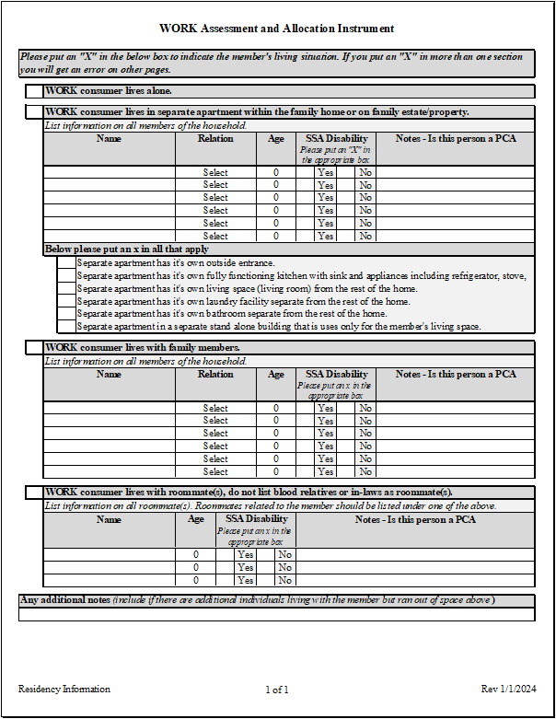
Working Healthy/WORK Training
WORK Residency Form
This page will provide vital information that will affect the application of the Informal Support policy.
If a member does not live alone all or part of the Informal Support policy could apply.
Roommates share some IADLs responsibility such as housekeeping, mowing or snow removal, etc.
  If a member lives with one roommate, then you would only allow 50% time for cleaning common areas. You would still allow 100% for cleaning private bedroom or private bathroom.
The information input on this page will cause information to automatically populate on the Other ADLs page and the IADLs pages.

Slide 51
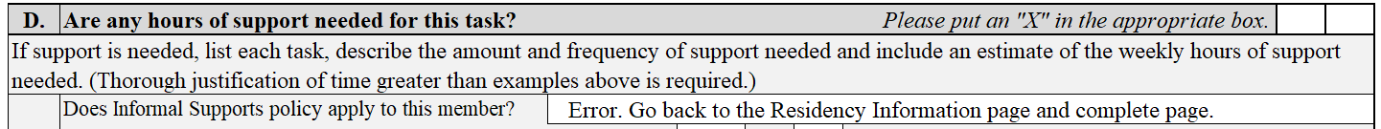
Working Healthy/WORK Training
Messages Based on the Residency Page:
Why is the information on the residency page important?
There are multiple sections of the assessment that can be impacted by the Informal Support policy. Based on the boxes you mark the tool will give you messages to cue you to look at this policy. The info you collect on the residency page will help you identify how to apply the policy.
If you get the below message, you didn’t indicate the member’s living arrangements correctly. Either you didn’t check a box or you check boxes in multiple sections.
Not Completed Correctly

Slide 52
Working Healthy/WORK Training
The Member Lives Alone:
This is self explanatory; the member does not live with anyone.
X
If you get the below message, you have indicated that the member does not live with anyone.
Member Lives Alone

Slide 53
Working Healthy/WORK Training
Automatic Message Related to Informal Support
When you indicate a member lives with someone, the sections relevant to this policy will give a message confirming if this policy could be applicable.
If you get the below message, you indicate the member’s living arrangements as living with someone. This means the Informal Support policy applies to some degree.
Member Lives With Someone

Slide 54
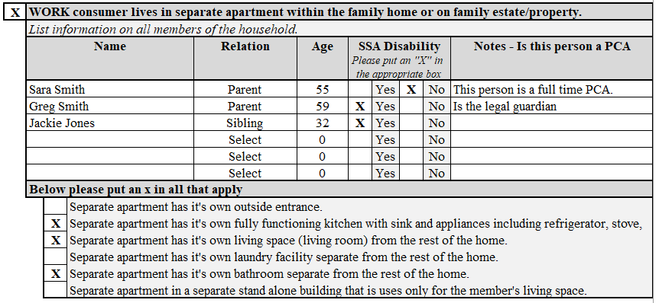

Working Healthy/WORK Training
The Member Lives with Someone:
There are 3 types of living arrangement when a member lives with someone. Depending on the relationship and the living arrangement can affect how this policy is applied. Refer to the Informal Support policy cheat sheet.
When a member indicates they live in a separate apartment in the family home you need to collect all the information in this section.

Slide 55
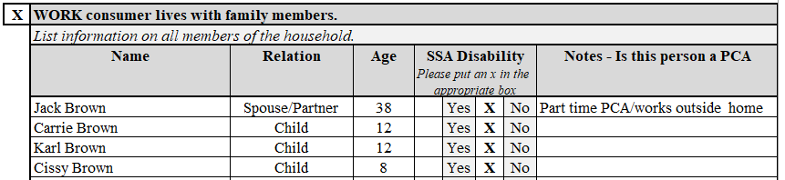

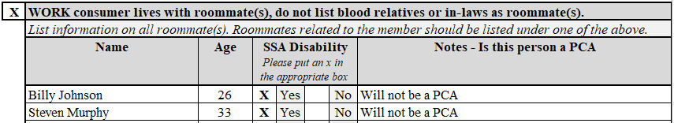

Working Healthy/WORK Training
The Member Lives with Someone:
This section is for a member living with family in the family home.
This section is for a member living with a roommate.

Slide 56
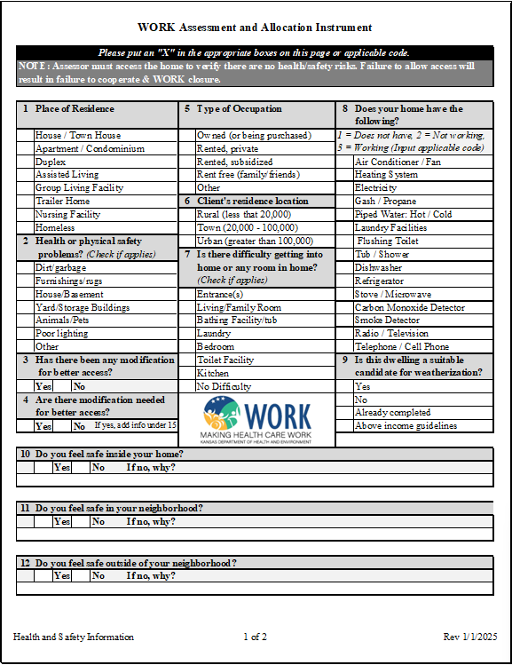
Working Healthy/WORK Training
Health Related Information
Complete the health-related section thoroughly.
It is important to note where members live and whether they own or rent their home.
Indicate if they have safety equipment in the home (smoke detector, carbon monoxide detector, etc.); have them demonstrate that the equipment is operational.
Indicate if they have any difficulty getting into their home, or a room in their home.
Note: When an Assistive Service request is submitted, this page is an important tool to review the request.

Slide 57
Working Healthy/WORK Training
Safety Information
SAFETY
Behavioral Health Issues: WORK is not designed to address mental health issues, e.g., anxiety, hoarding; these issues must be addressed by Community Mental Health Agencies.
Physical Health Issues: members who are living in hazardous conditions should be referred to Adult Protective Services within the Department of Children and Families.
WORK does not pay for extermination of pests in the home or clean up hoarding issues.
S Search for Hazards
A Analysis the Risk
F Find the Cause
E Eliminate the Cause
T Tell Others
Y You Are Safe

Slide 58
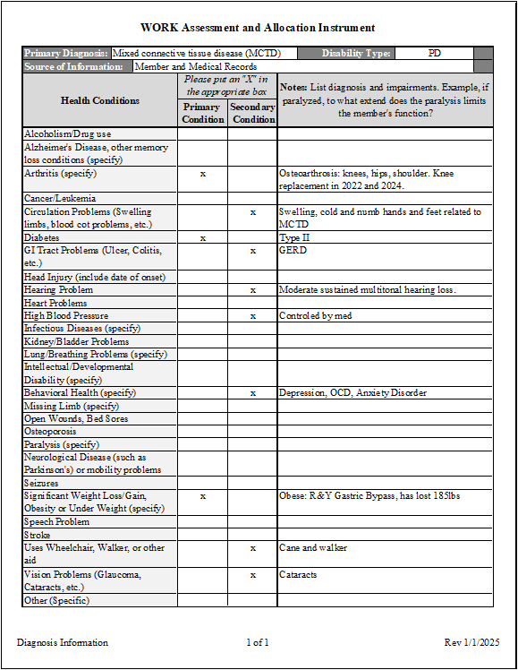
Working Healthy/WORK Training
Diagnosis Information
Complete this page with assistance from member.
Identify primary and secondary conditions. Should have at least primary condition relative to the type of disability e.g. I/DD, PD, BI.
Provide sufficient information for a full picture of the medical conditions and disabilities which result in the need for support(s).
1
2

Slide 59
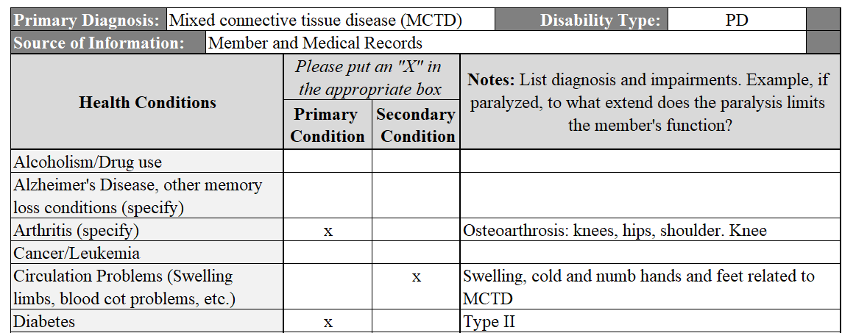
Working Healthy/WORK Training
Back to Previous
Diagnosis Information
Identify primary and secondary conditions. Should have at least 1 primary condition relative to the type of disability e.g. I/DD, PD, BI.

Slide 60
Working Healthy/WORK Training
Click for Next
Diagnosis Information
Provide sufficient information for a full picture of the medical conditions and disabilities which result in the need for support(s).
For example:
Is the condition a result of injury? If so, indicate how this occurred?
If the member takes medication(s) for a condition, is the condition controlled or uncontrolled?
If a condition can impact the member in a lot of ways, make sure to provide the details, e.g., Cerebral Palsy, Arthritis, Paralysis, etc.

Slide 61
Working Healthy/WORK Training
Primary Condition(s)
At least 1 primary condition should be directly related to the type of disability i.e., I/DD, PD, BI.
Secondary Condition(s)
Don’t forget about other conditions.
Diagnosis Information Recap
  Provide details about all conditions.
    Instead of “arthritis”, it is helpful to give details such as “arthritis in hands”.
    Instead of paralysis, explain whether the member has paraplegic, quadriplegic, with limited ability or no ability to stand without assistance.
    Details go a long way to provide justification of needed supports.

Slide 62

Working Healthy/WORK Training
Thank You
If you have questions regarding this training, please email your questions to:
Sherri Marney, WORK Program Manager
Sherri.Marney@ks.gov

